Slide 1
Driver Drowsiness Detection System
Submitted by: Vivek Kumar Singh (181500819)
Jitendra Parmar (181500299)
Abhishek Gupta (181500016)
Submitted to:
Priya Agarwal

Slide 2
Motivation
According to the National Highway Traffic Safety Administration, every year about 100,000 police-reported crashes involve drowsy driving. These crashes result in more than 1,550 fatalities and 76,000 injuries. The real number may be much higher, however, as it is difficult to determine whether a driver was drowsy at the time of a crash. So, in order to make the driver aware before any such accident occurs, we have made this system. It predicts the eye and mouth landmarks in order to identify if a person is falling asleep, by checking if his eyes are closed or if he is yawning.

Slide 3
Problem Defination
In the real time driver fatigue detection system it is required to slow down a vehicle automatically when fatigue level crosses a certain limit. Instead of threshold drowsiness level it is suggested to design a continuous scale driver fatigue detection system. It monitors the level of drowsiness continuously and when this level exceeds a certain value a signal is generated .

Slide 4
Hardware and Software Requirements
Hardware :
• Minimum 2GB RAM
• i3 Processor
• Laptop with basic Hardware
• Webcam

Slide 5
Cont...
Software:
• Pycharm
• Anaconda
• Operating System(Window)
• Programming Language
• Python with OpenCv

Slide 6
Introduction
Driver drowsiness detection is a car safety technology which prevents accidents when the driver is getting drowsy. Various studies have suggested that around 20% of all road accidents are fatigue-related, up to 50% on certain roads. Driver fatigue is a significant factor in a large number of vehicle accidents. Recent statistics estimate that annually 1,550 deaths and 76,000 injuries can be attributed to fatigue related crashes.
By monitoring the eyes, it is believed that the symptoms of driver fatigue can be detected early enough to avoid a car accident. Detection of fatigue involves the observation of eye movements and blink patterns in a sequence of images of a face.

Slide 7
What is open-cv ?
Computer vision is a field of study which encompasses on how computer see and understand digital images and videos.
Computer vision involves seeing or sensing a visual stimulus, make sense of what it has seen and also extract complex information that could be used for other machine learning activities.

Slide 8
Applications of Computer Vision
There are some practical applications of computer vision:
1.Facial Recognition - This is a very important application of computer vision
where electronics use facial recognition technology to basically validate the
identity of the user.
2. Image Search and Object Recognition — Now we could search objects
in an image using image search. A very good example is google lens where
we could search a particular object within the image by clicking the photo of
the image and the computer vision algorithm will search through the catalogue
of images and extract information out of the image.

Slide 9
Cont.
For our project we need two type of Classifiers :
haarcascade_frontalface_default.xml:We will implement our project using the Haar Cascade classifier. Haar Cascade classifier is an effective object detection approach which was proposed by Paul Viola and Michael Jones in their paper, “Rapid Object Detection using a Boosted Cascade of Simple Features” in 2001.

Slide 10
2. shape_predictor_68_face_landmarks.dat : It‘s a landmark’s facial detector with pre-trained models, the dlib is used to estimate the location of 68 coordinates (x, y) that map the facial points on a person’s face like image below.

Slide 11
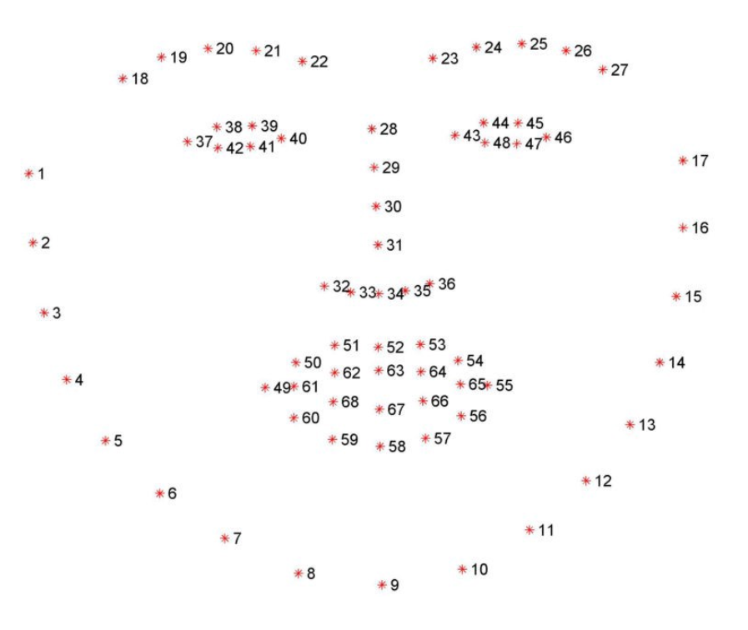

Slide 12
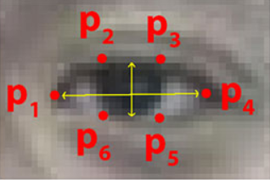

Eye Aspect Ratio
Eye blinks can be detected by referencing significant facial landmarks. For eye blinks we need to pay attention to points that describe the eyes.
Based on given fig. The EAR can be defined below equation

Slide 13
Implementation
In our program we used Dlib, a pre-trained program trained on the dataset to detect human faces using the pre-defined 68 landmarks.
After passing our video feed to the dlib frame by frame, we are able to to detect left eye and right eye features of the face.
Now, we drew contours around it using OpenCV.
Using Scipy’s Euclidean function, we calculated sum of both eyes’ aspect ratio which is the sum of 2 distinct vertical distances between the eyelids divided by its horizontal distance.

Slide 14
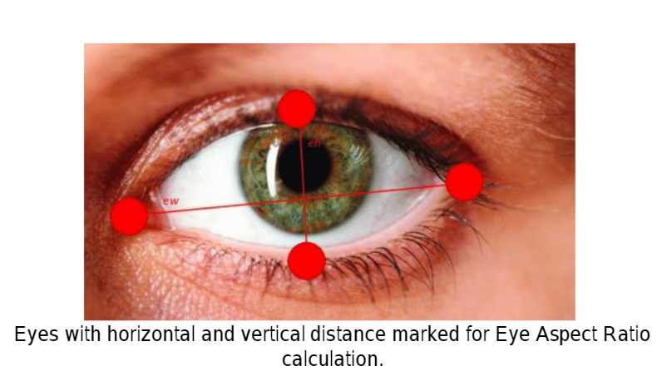
Cont…
Now we check if the aspect ratio value is less than 0.25 (0.25 was chosen as a base case after some tests). If it is less an alarm is sounded and user is warned

Slide 15
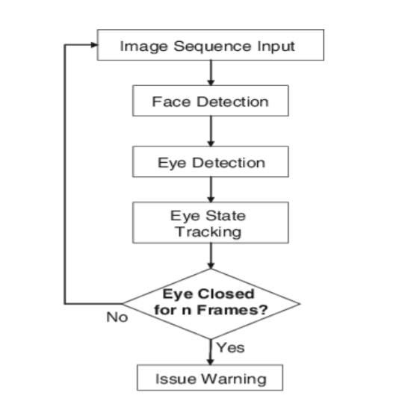
Block Diagram

Slide 16
THANK YOU

